Slide 1
Product Research
sdmay25-25

Slide 2
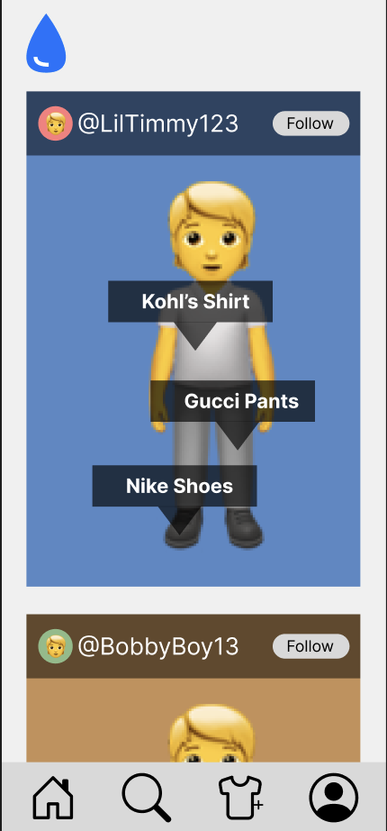
Project Overview
Website and cross-platform mobile app to make public posts with clothing items
View details about the clothing items in the images
Get the best deal by comparing the price of the item at various retailers

Slide 3
Problem Statement
In today's fashion industry, consumers face a time-consuming process when searching for clothing items. Finding inspiration, identifying specific products, and discovering the best places to purchase them often requires navigating multiple platforms, websites, and reviews. This disjointed experience creates frustration and inefficiency for users who want a seamless way to explore fashion trends, find detailed product information, and make informed purchase decisions.
Consumers need a unified solution that combines the social aspects of fashion inspiration with a streamlined shopping experience, all while providing accurate product details, pricing, reviews, and purchase options. Additionally, the ability to discover similar products based on user preferences is lacking in many existing solutions.
DripDrop aims to address this problem by offering a social media-inspired platform where users can share and explore fashion items, access relevant product information, and easily connect with purchase options—all in one place.

Slide 4
Related Products
Honey
Online shopping tool for coupons and price comparisons
ShopSavvy
Online shopping tool for price comparison and price tracking
LTK
Allows users to shop for different styles/looks based on creator guided looks and product recommendations

Slide 5
Market Gap
Specialized Products
No specialized products for specific online shopping aspects so everything is generalized with no specific features
No dedicated apparel discount app exists
Social Aspect
General social media apps exist, but nothing specific to apparel where people can communicate with others
Store Locator
Store locators for apparel sales in the nearby area does not explicitly exist

Slide 6
Product Ideas/Features
DripDrop:
Price Comparison
Web scraping to extract product information
View price trends
Use AI model to suggest similar products

Slide 7
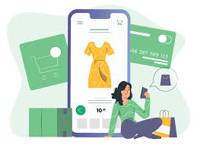
Conclusion
Unified platform to bridge the gap between clothing inspiration and shopping
Leverage modern technologies including AWS, React, and Typescript
Cross platform solution

