Slide 1
dripdrop
sdmay25-25
Kolby Kucera, Kaden Wingert, Logan Roe, Gavin Rich, Zach Foote, Elyse Kriegel

Slide 2
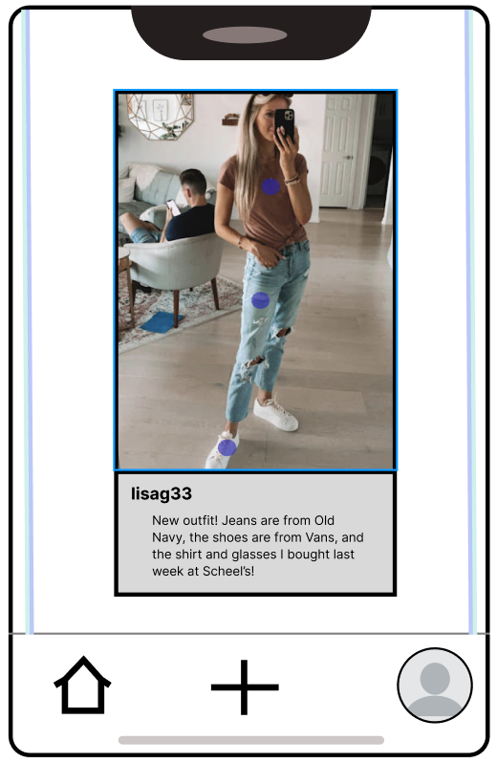
Project Overview
Website and cross-platform social media app for online shopping
View details about the clothing items in the images
Get the best deal by comparing the price of the item at various retailers

Slide 3
Problem Statement
Consumers face a time-consuming process when searching for clothing items
Discovering the best places to purchase them often requires navigating multiple platforms, websites, and reviews
Leads to frustration and inefficiency for users
Consumers need a unified solution
Combine the social aspects of fashion inspiration with a streamlined shopping experience
Provide accurate product details, pricing, reviews, and purchase options
Discover similar products based on user preferences is lacking in many existing solutions

Slide 4
Problem Statement - Our Solution
Social media-inspired platform where users can share and explore fashion items
Access relevant product information, and easily connect with purchase options—all in one place.

Slide 5
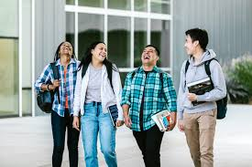
Users - Young adults
Primary users
Looking for fashion inspiration
Explore clothing items, find product information, and make purchases

Slide 6
Users - Influencers
People who actively share fashion trends, outfits, and product recommendations
Inspire consumers by creating posts and content
Collaborate with brands or retailers for promotions and partnerships.
Access analytics to understand their audience's preferences and engagement

Slide 7
Online Shoppers
People who love to search for apparel online; are actively trying to upgrade their wardrobe
Will be looking for new fashion trends, they will also be looking for cloths that are visually appealing but have good prices
Will want to view an abundance of clothes to view at a high pace

Slide 8
Users - Social Media Users
Users who leverage their fashion sense and online presence to share their styles, inspire followers, and promote products
Share curated outfits, clothing items, and fashion trends with their audience
Discover new products and collections recommended by community members

Slide 9
Users - Parents
Parents shopping for their children or looking for fashion inspiration and practical clothing solutions for families
Discover trendy and practical clothing for children, teens, and the entire family
Find clothing items that are suitable for various age groups, occasions (e.g., school, sports, formal events), and weather conditions
Look for promotions or deals on children's clothing

Slide 10
User Needs
A place to view various clothing items and outfits people want to share
A place to post their outfits for others to view and interact with
Cheaper options for the clothes they want
Similar, cheaper products to get the same look with a cheaper price
Discounts on the products they desire
A simple and easy to use UI
Reliable data storage so that past actions are always saved

Slide 11
Conclusion
User’s viewpoints and perspectives will be extremely important in how we develop the features of dripdrop.
Features that will be affected by the user groups include the:
User interface
Simplicity of the design
Way that information is stored and accessed
Ease of actions within the app (viewing and posting)
Methods of saving money (e.g. getting better deals on the outfits, posting sales, etc.)
By tending to these user needs we can create a platform that will not only draw users in, but give them the experience that they are looking for and will leave them wanting to continue using the app

