Slide 1
dripdrop
sdmay25-25
Kolby Kucera, Kaden Wingert, Logan Roe, Gavin Rich, Zach Foote, Elyse Kriegel

Slide 2
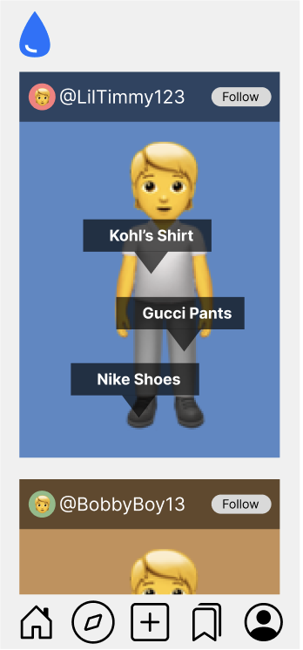
Project Overview
Cross-Platform apparel social media and online shopping app
Get inspiration for new outfits
Compares prices of similar items across various retailers to find the best deals

Slide 3
User Needs
A place to view various clothing items and outfits people want to share
A place to post their outfits for others to view and interact with
Cheaper options for the clothes they want
Similar, cheaper products to get the same look with a cheaper price
Discounts on the products they desire
A simple and easy to use UI
Reliable data storage so past actions are always saved

Slide 4
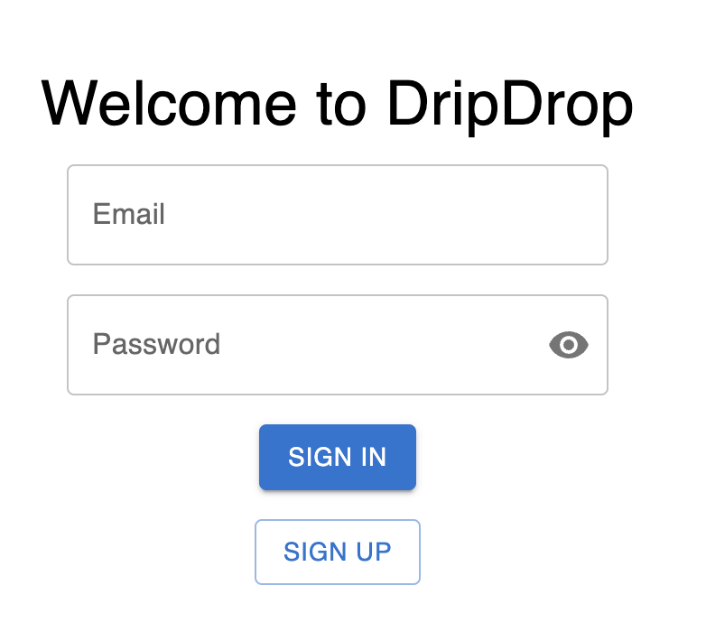
Requirements - Functional
Sign up via email or social media accounts
Users can create and update their profile with basic information such as name, profile picture, and bio
Users can follow other users to see their clothing posts and like/comment on them
Users can upload images of their clothing with descriptions (brand, price, size, etc.)
The app will automatically suggest tags based on image recognition (e.g., "denim jacket," "red shoes")

Slide 5
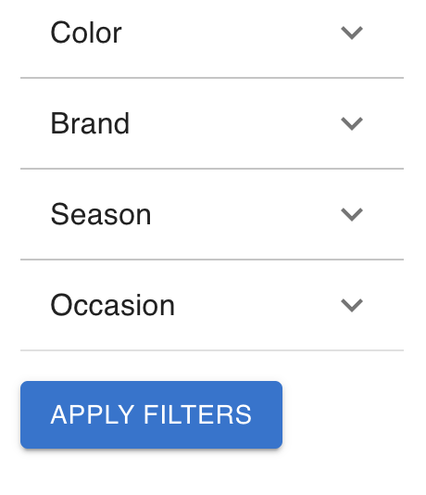
Requirements - Functional Continued
The product must allow users can search for products by name, brand, or category (e.g., "Nike sneakers")
The product must implement advanced filters (size, color, price range, brand, etc.)
When a user clicks the save ribbon, the product or outfits they like will be added to their wishlist for future reference
When a user’s wishlist product has dropped in price or is running out of stock, the app will notify the user

Slide 6
Requirements - Resource
The system must integrate with external retail APIs (e.g., Amazon, eBay, Walmart) to fetch product details, prices, availability, and alternatives
The system must dynamically scale API requests based on user volume
The system must use AWS S3 to handle user-uploaded media
The system must use AWS S3 for static website hosting
The system must leverage AWS SNS to send price drop notifications to subscribers

Slide 7
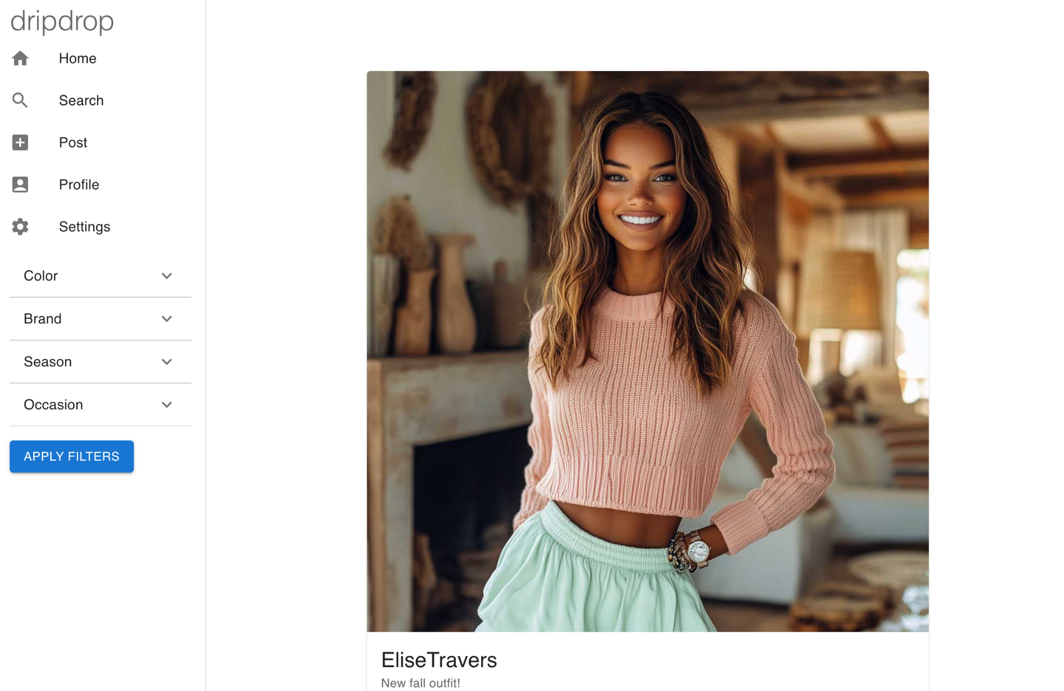
Requirements - Aesthetic
The product must adhere to modern UI/UX standards & be visually appealing
The system must use clear typography for better readability, with defined font hierarchy (headers, subheaders, body text) to enhance user navigation
The social feed should be designed with an emphasis on simplicity and clarity, similar to leading social media platforms (e.g., Instagram).
The product must provide visual feedback (e.g., color changes, shadows) for interactive elements such as buttons, links, and images when hovered or clicked

Slide 8
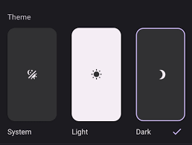
Requirements - User Experiential
The UI should be easy to navigate, with a clear and well-organized menu for accessing different screens
When a product is viewed, users should be able to compare alternative products and their prices
Users should be able to personalize their experience by choosing color themes (e.g., dark mode, light mode)
Lazy loading should be implemented for images and posts in the social feed, loading content as users scroll for a smoother experience
The app will provide clear error messages when undesired behavior occurs (e.g., product not found) with suggestions for recovery (e.g., "Try Again," "Go Back to Search").

Slide 9
Engineering Standards - UI/UX Design and Interaction
ISO 9241-210 (Human-Centered Design): Ensure the product's user interface and interactions are designed according to human-centered design principles for a seamless user experience
Standard: ISO 9241-210:2019 (Human-centered design for interactive systems).
Material Design Guidelines: For Android, follow Google's Material Design principles to ensure the app's UI is consistent and intuitive
Standard: Google Material Design Guidelines
Apple HIG (Human Interface Guidelines): For iOS, follow Apple's Human Interface Guidelines (HIG) to create visually appealing and usable mobile interfaces
Standard: iOS Human Interface Guidelines

Slide 10
Engineering Standards - Data Handling and Privacy
ISO/IEC 27001 (Information Security): Ensure the app follows information security management best practices, ensuring that sensitive customer data, like personal details and payment information, is protected
Standard: ISO/IEC 27001:2013 (Information security management)
SO/IEC 29100 (Privacy Framework): Implement privacy standards to protect user information in compliance with global privacy laws
Standard: ISO/IEC 29100:2011 (Privacy Framework)

Slide 11
Conclusion
User’s viewpoints and perspectives will be extremely important in how we develop the features of dripdrop.
Features that will be affected by the user groups include the:
User interface
Simplicity of the design
Way that information is stored and accessed
Ease of actions within the app (viewing and posting)
Methods of saving money (e.g. getting better deals on the outfits, posting sales, etc.)
By tending to these user needs we can create a platform that will not only draw users in, but give them the experience that they are looking for and will leave them wanting to continue using the app

