Slide 1
dripdrop
Group 25
Zachary Foote, Kaden Wingert, Kolby Kucera, Logan Roe, Elyse Kriegel, Gavin Rich

Slide 2
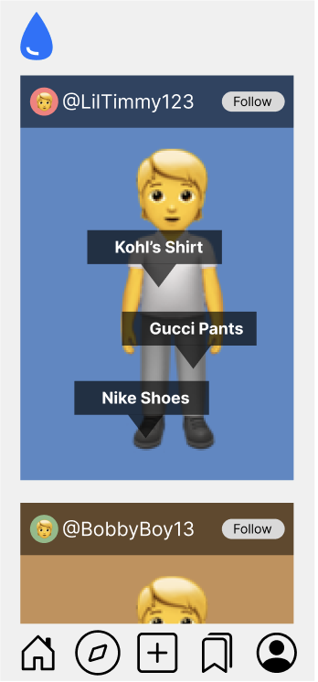
Project Overview
Apparel-centric social media app
Users post their daily outfits
Specific feed based on following and apparel interests
Affiliate links on products
Smaller account can have ability to get points for posting
AI recommends similar looking products
Saving users money while still getting the desired look

Slide 3
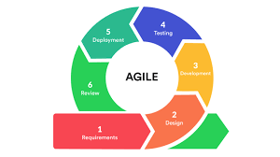
Project Management Style - Agile
Rapid Iterations and Flexibility
Prioritization of Features
Focus on tasks which deliver the most value
Collaboration and Team Efficiency
2 week sprints
Standup meetings
https://www.softrizon.com/about/software-development-methodologies/

Slide 4
Task Decomposition
Database
Create Aurora Database
Create Tables
Mobile App / Website
Sign up/Sign In
Picture-Taking Functionality
Posts/Feed Page
API
User, Post, Image Table
Implement Full ER Diagram
Improve Performance

Slide 5
Key Milestones
Basic UI Functionality
Website Demo
ETC: End of December
Application Demo
ETC: Mid April
Suggesting Similar Products Using AI
AI will tag a photo with various tags autonomously
These tags will be used to find the best match to the current product
ETC: Mid April
Tags
Red Shirt
Ripped Jeans
Black Belt
Sunglasses
Black Shoes

Slide 6
Metrics/Evaluation Criteria
Basic functionalities(following people/posting/etc.)
Fast retrieval and display of data
Easy, simple GUI
AI
Closeness of the match
Number of found matched clothes
Navigation
Ease of searching, going to another page
Affiliate Links
Do they work on both original post and AI matches

Slide 7
Conclusion
Next Steps
Iterate & Improve
Use key milestones to guide our development
Meet and review progress regularly
Agile Approach
Build upon and expand our goals
Add/Remove Features from Plan
Continuously Iterate and Improve

Slide 8
Questions?

Slide 9
Potential AI Implementations
Using OpenAI API
Pros:
Easy to implement
Relatively fast outputs
Dynamic uses
Cons:
Expensive
Model is very general
Using an Open Source Model
Pros:
Also easy to implement
Large amount of options to use
Lots of well written documentation
Cons:
Good models are very large in size
Also most models are made for general use cases
Using a Custom Model
Pros:
Can be customized to fit our exact needs
Can be trained on data we chose
Cons:
Very difficult to implement
Training can be intensive

