Slide 1
dripdrop
Group 25
Faculty Advisor: Simanta Mitra
Zachary Foote, Kaden Wingert, Kolby Kucera, Logan Roe, Elyse Kriegel, Gavin Rich

Slide 2
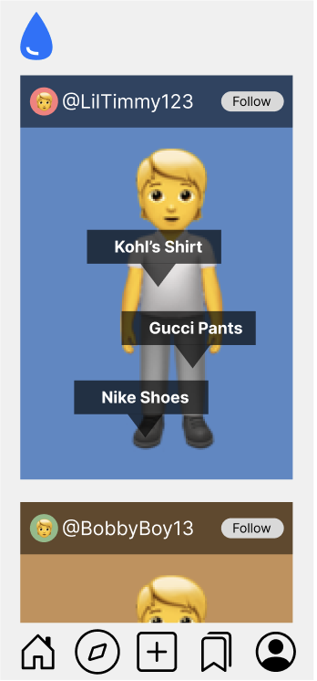
Project Overview
Apparel-centric social media app
Users post their daily outfits
Specific feed based on following and apparel interests
Affiliate links on products
Smaller account can have ability to get points for posting
AI recommends similar looking products
Saving users money while still getting the desired look

Slide 3
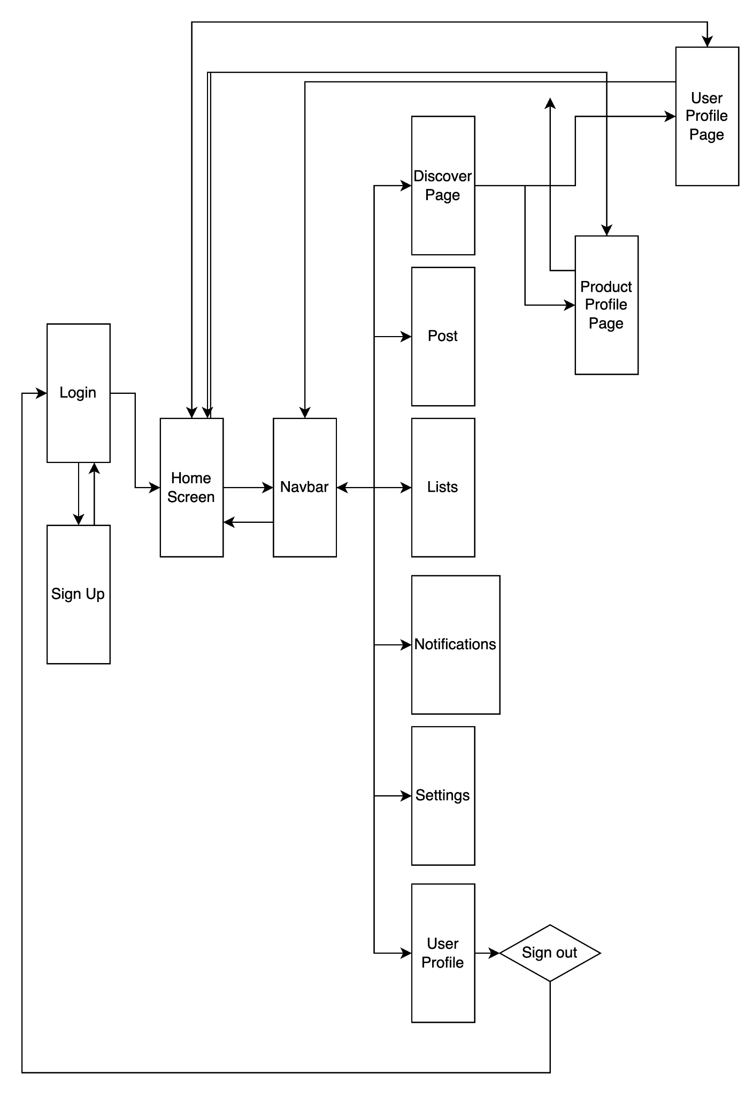
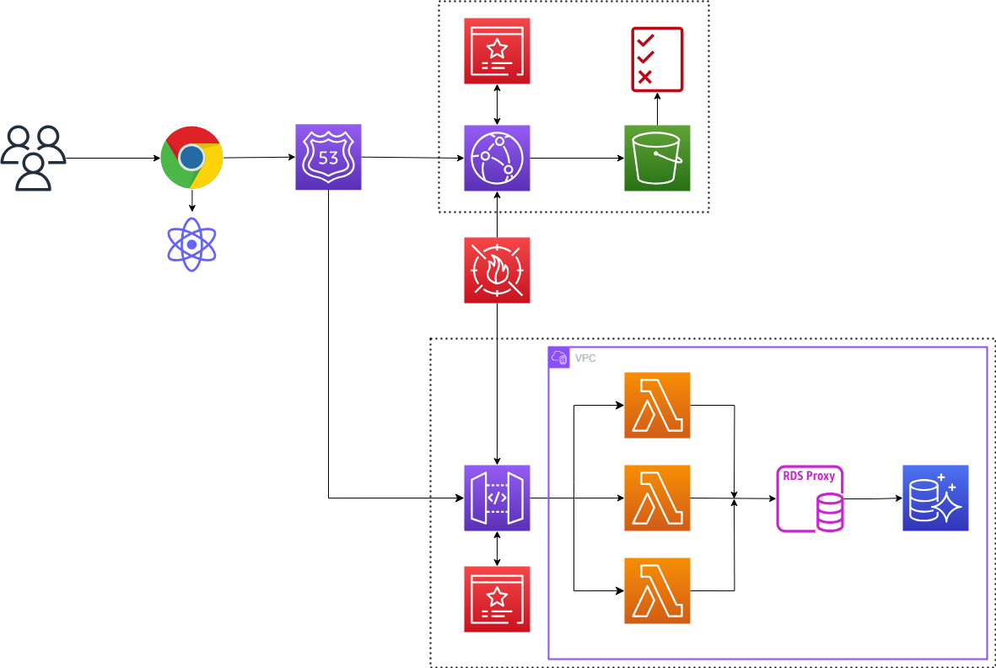
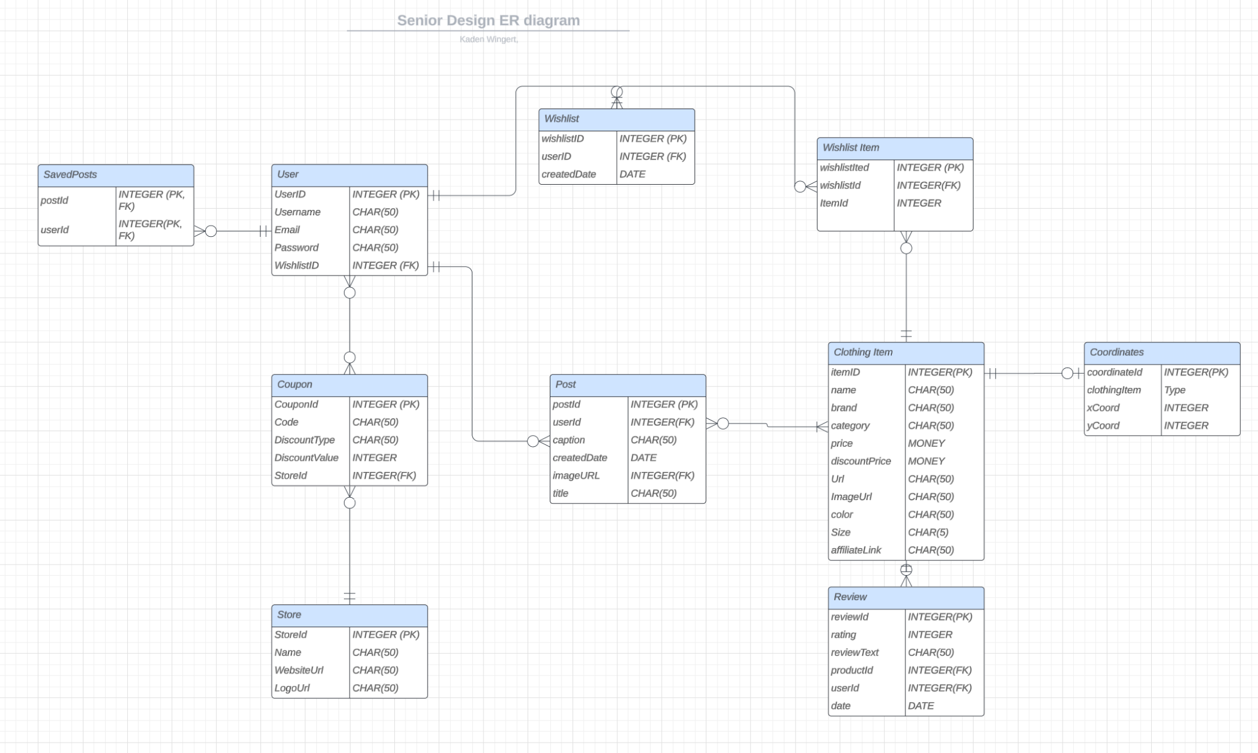
Detailed Design and Visuals
Frontend Flow
AWS Figure
ER Diagram

Slide 4
Key Functionalities
User Authentication
Secure sign-in, sign-up, password recovery
User Profile
Customizable profiles, ability to add friends, preferences and privacy settings
Posts + Feed
Interactive posts with option for users to include links to product websites
Personalized feed tailored to users interests
Product Comparison
AI-powered recommendations for similar items + price comparisons
Saved Posts
Bookmark posts for later reference
Reward System
Earn points for interactions and used links regardless of follower count or status

Slide 5
Technology Considerations
Our Technology - AWS
Provides greater flexibility of resources
More advanced AI/ML services
Requires careful planning to ensure cost-efficiency
More pricing models
Deeper functionality in compute and database services
Alternative - Microsoft Azure
Comparable scalability and integration to AWS
More enterprise-focused rather than small business
Smaller cloud provider market share
Better integration with Microsoft products
Better pricing for SQL databases

Slide 6
Technology Considerations
Our Solution - React.js
Only focuses on the view layer
Javascript based-library
Greater flexibility for integrating with other libraries or tools
Open-source with a large developer community making it easy to find support
Modular components, which improves maintainability and scalability
The virtual DOM enhances performance
Alternative - Angular
Full-fledged Model-View-Controller framework
Typescript based web app framework
View routing, HTTP requests and testing are built in
Requires less code than React
Steeper learning curve

Slide 7
Areas of Concern and Development
AI Integration
Very little previous experience with AI development
Need to find most effective and overall best training method for custom model
Web Scraping
APIs vs Web Scraping
Legality
User Experience (UX)
Need to insure user experience is satisfactory and engaging
Making design intuitive but also unique and distinct from similar applications
Tradeoffs for performance and stability
Caching options
Server costs
Unified development vs Platform-Specific development (React Native vs Swift, Kotlin, etc.)

Slide 8
Conclusion
Next Steps
Iterate & Improve
Use key milestones to guide our development
Meet and review progress regularly
Agile Approach
Build upon and expand our goals
Add/Remove Features from Plan
Continuously Iterate and Improve

