Slide 1
dripdrop
Group 25
Faculty Advisor: Simanta Mitra
Zachary Foote, Kaden Wingert, Kolby Kucera, Logan Roe, Elyse Kriegel, Gavin Rich

Slide 2
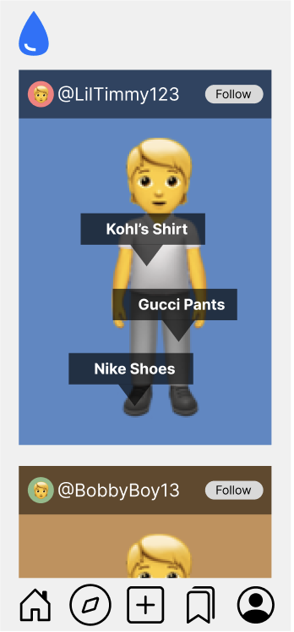
Project Overview
Apparel-centric social media app
Users post their daily outfits
Specific feed based on following and apparel interests
Affiliate links on products
Smaller account can have ability to get points for posting
AI recommends similar looking products
Saving users money while still getting the desired look

Slide 3
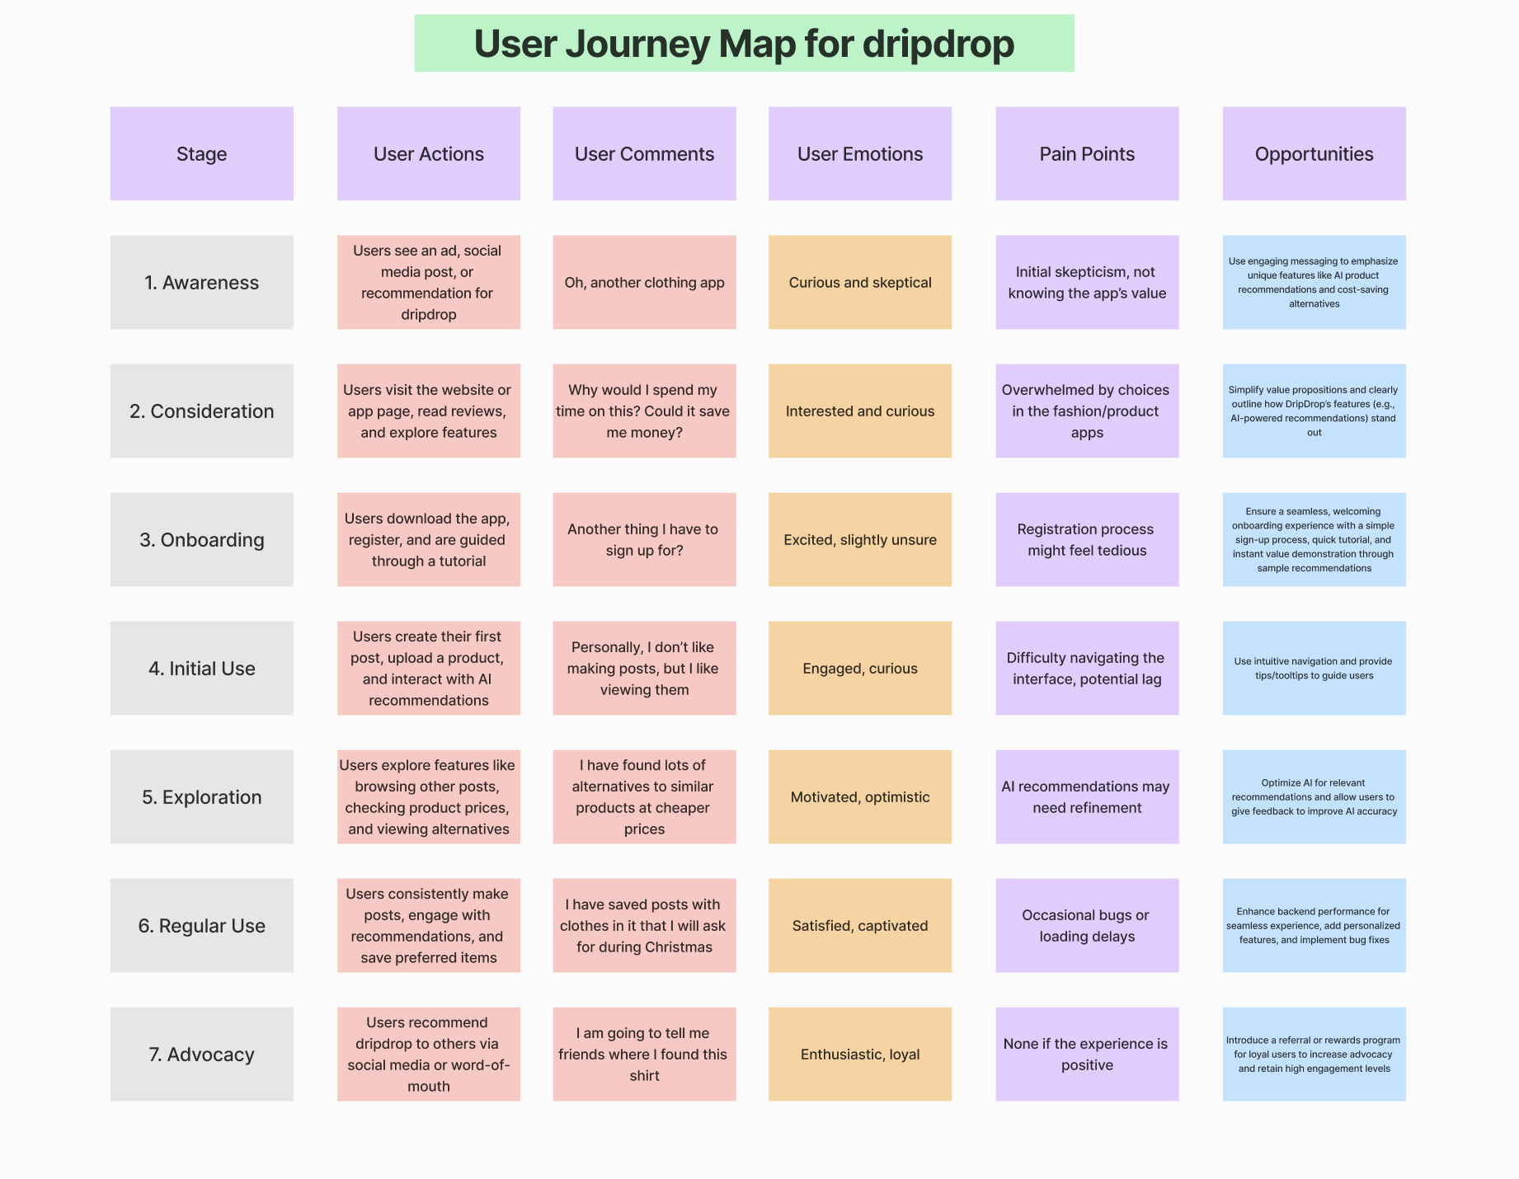
Artifacts
Begins with user skepticism
Transitions to user onboarding
Then goes into exploration
Concludes with user referrals
https://www.figmahttps://www.figma.com/board/RAUaactFuERHXmoXlENR5J/Gantt-Chart?node-id=0-1&node-typ e=canvas&t=vEUNRQ8EarDbsEsQ-0.com/board/RAUaactFuERHXmoXlENR5J/Gantt-Chart?node-id=0-1&node-typ e=canvas&t=vEUNRQ8EarDbsEsQ-0

Slide 4
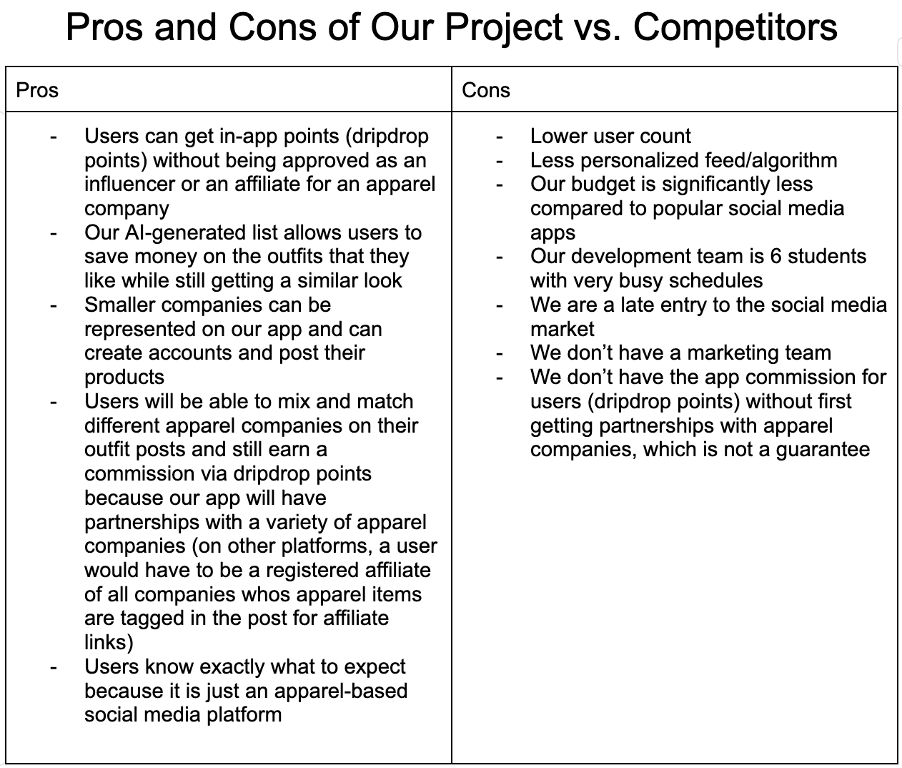
Artifacts
Highlights
In-app currency promotes customer loyalty
Allows advertising for small businesses
Our team doesn’t have marketing skills
We lack a large user base required by social platforms

Slide 5
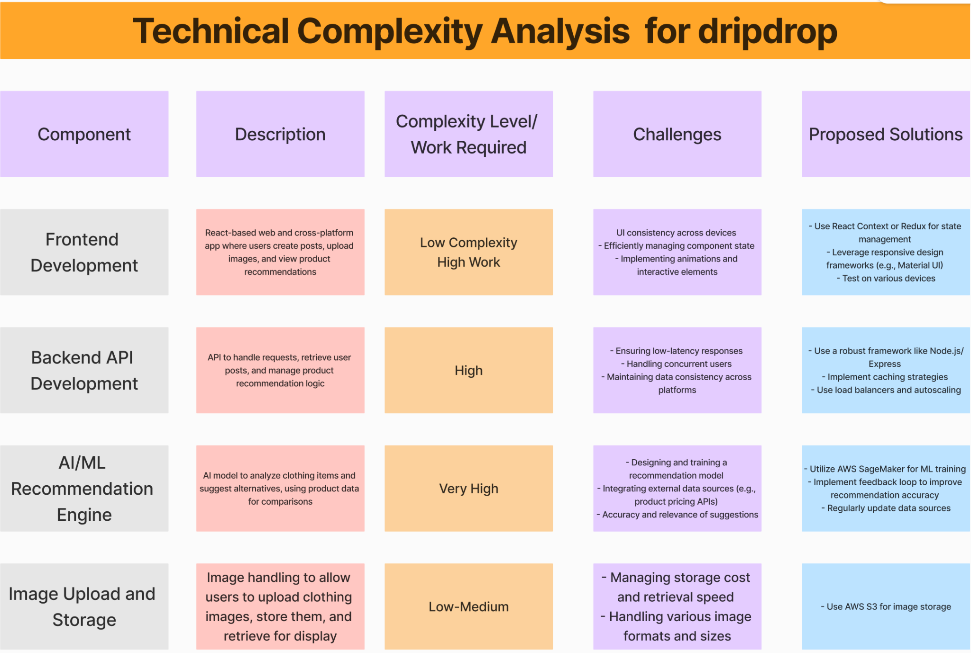
Artifacts

Slide 6
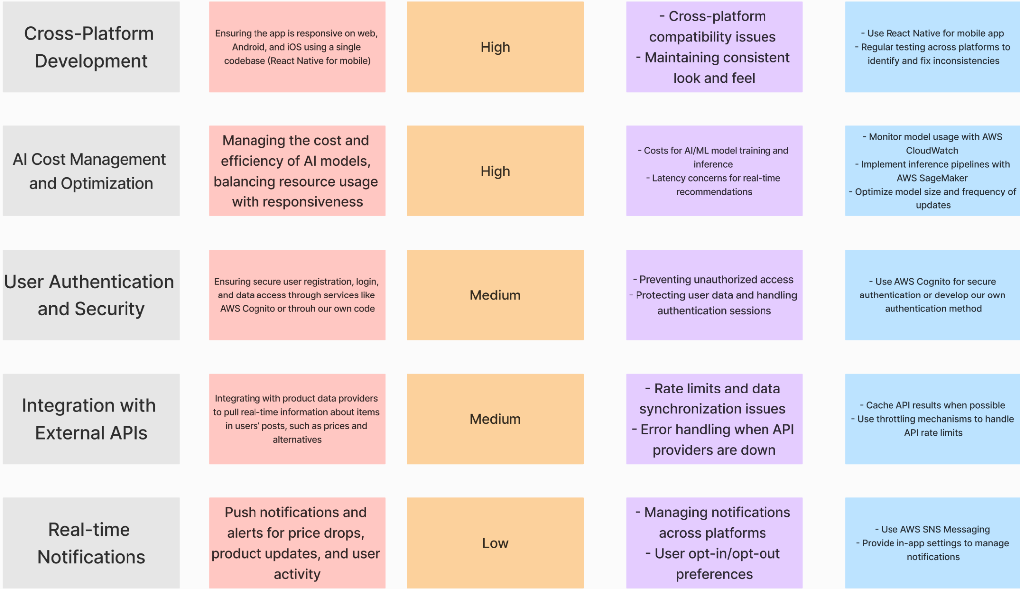
Artifacts - Technical Complexity Analysis (Continued)

Slide 7
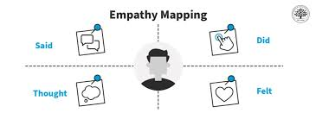
Human - User Needs
How does current solution address User needs?
1. Familiar Social Media app functionality
Users will feel comfortable navigating app
2. No requirement for rewards
All users can take advantage of rewards
3. Saved Posts
allows users to easily find posts later
4. Similar products
Help users save money + time finding products
Potential Improvements:
1. Advanced Search and Filtering
Allow users to more easily find the content they are looking for
2. Recommended Posts
Improve experience by showing users posts similar to their previous activity
3. User Profile Analytics
Users can use data on their posts to see what methods generate more activity

Slide 8
Economic
Improvements
Drawbacks
Allows anyone to earn dripdrop points for posting outfits and getting clicks
AI generated list of similar, cheaper outfits
Completely free app to use for all users
ROI may be slow
Will not cost users anything
Affiliate links may be difficult to get
Once obtained, will generate money without costing users

Slide 9
Technical
Internal Complexity:
Working API, backend, and database
AI fit-matching
Collecting information on posted apparel items (cost, sales, etc.)
Tests ability on full-stack web development, typescript and python knowledge, web scraping, and AI model creation
External Complexity:
Smooth, visually aesthetic user interface
Finding users/companies to demo the app
Tests frontend coding knowledge. Additionally tests entrepreneurship skills.

Slide 10
Conclusion
Next Steps
Iterate & Improve
Use key milestones to guide our development
Meet and review progress regularly
Agile Approach
Build upon and expand our goals
Add/Remove Features from Plan
Continuously Iterate and Improve

