Slide 1
dripdrop
Group 25
Faculty Advisor: Simanta Mitra
Zachary Foote, Kaden Wingert, Kolby Kucera, Logan Roe, Elyse Kriegel, Gavin Rich

Slide 2
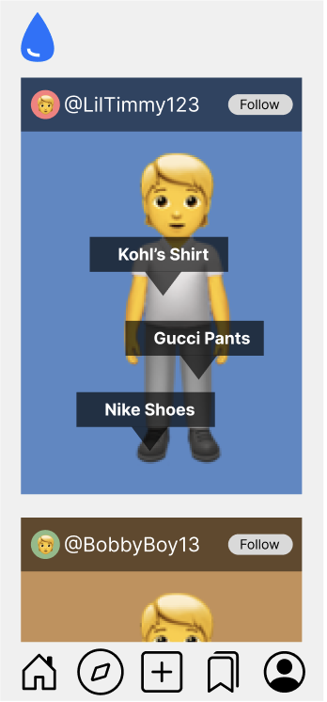
Project Overview
Apparel-centric social media app
Users post their daily outfits
Specific feed based on following and apparel interests
Affiliate links on products
Smaller account can have ability to get points for posting
AI recommends similar looking products
Saving users money while still getting the desired look

Slide 3
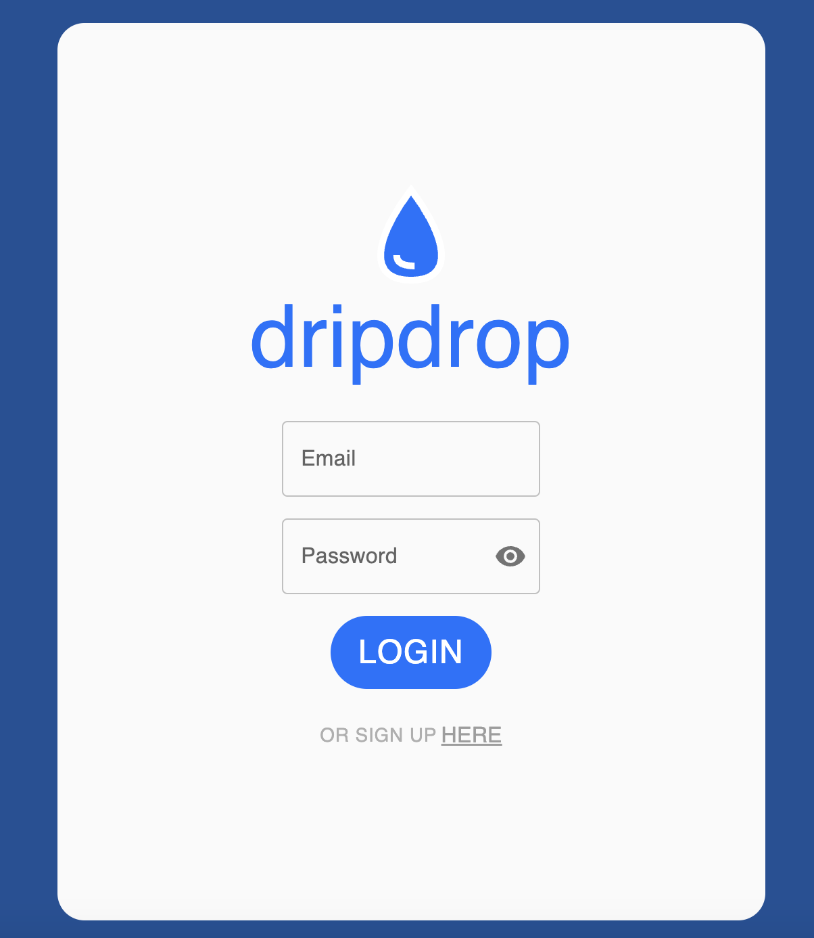
Prototypes - Website UI
Our website prototype is not our complete product
Some areas need UI improvements and were put together for the purpose of a presentable demo
It consists of:
Sign up and sign in pages
Home screen with posts
Filter options (UI only)
Ability to view and change account information
Create Posts
Search users or posts

Slide 4
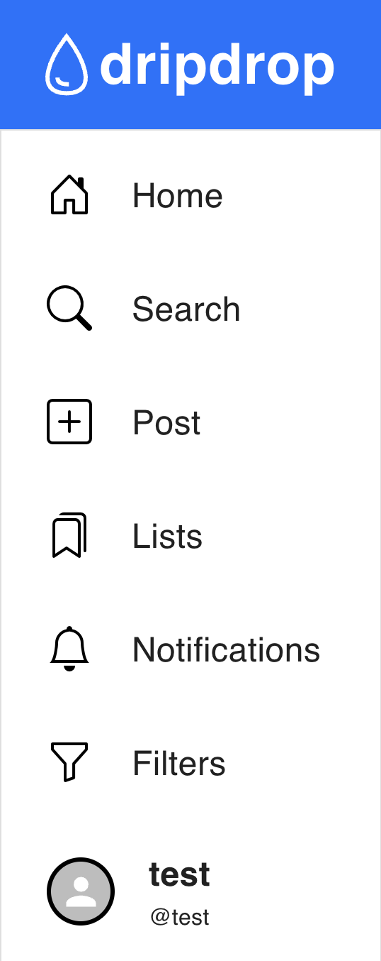
Prototypes - Website UI
View a demo video
View our live website
https://drive.google.com/file/d/10U5JQZMmsxJojrozQgqac443dmZHoDjd/view?usp=drive_link
https://www.dripdropco.com

Slide 5
Prototypes - Website UI
What we learned
Important to provide user feedback in forms (sign up, sign in, etc.)
Many different options are possible for structuring the backend endpoints
Having a frontend mockup helps increase UI development time efficiency

Slide 6
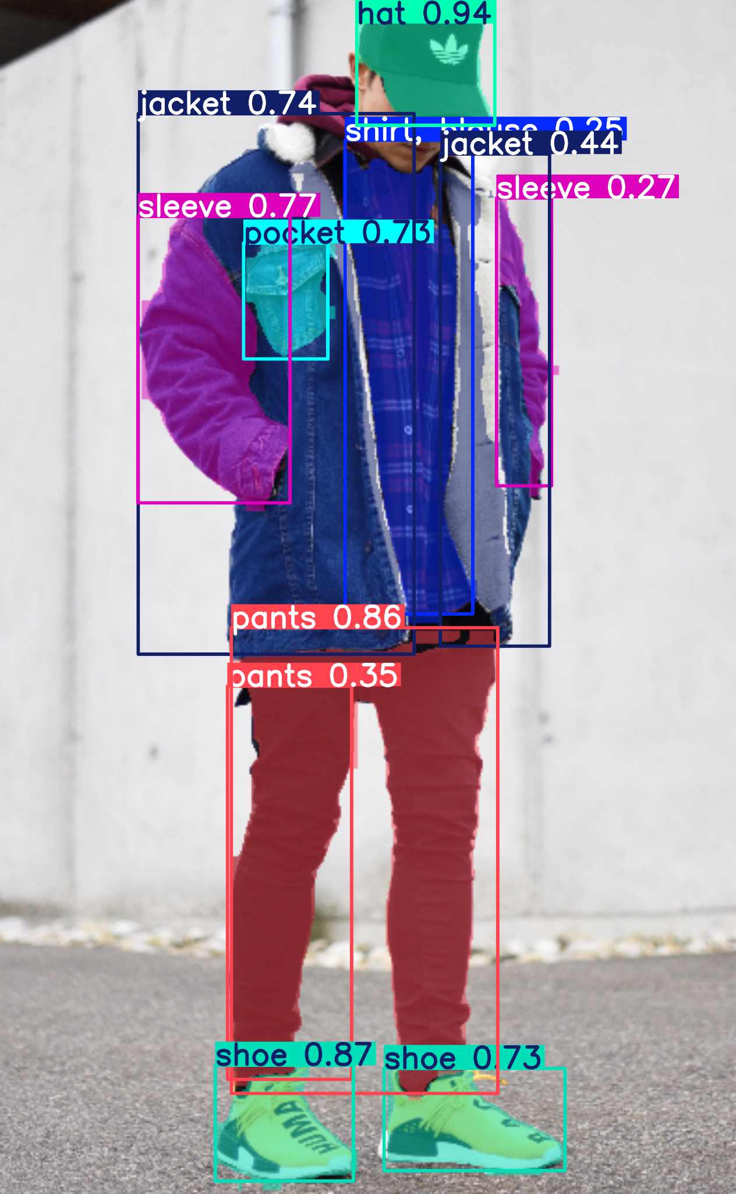
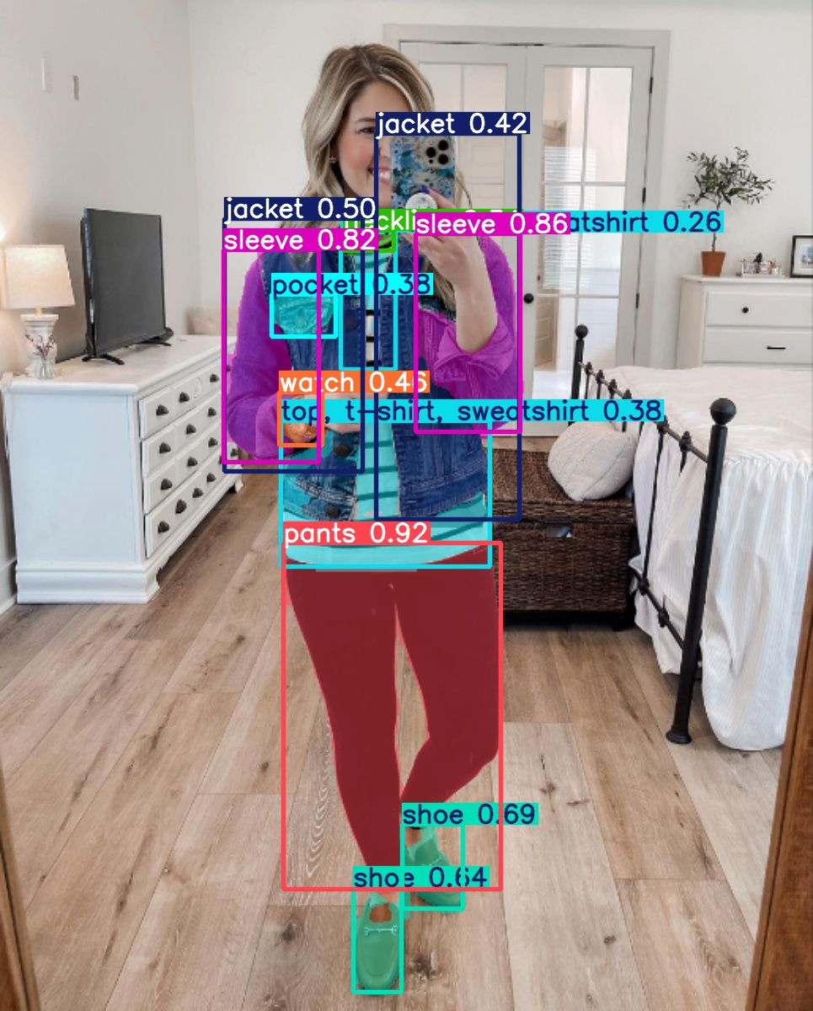
Prototypes - AI
Testing on many different models
Finding multiple datasets and modifying the datasets to get good training
Training the ai model locally and on the cloud to get faster and more accurate models to test
Inputting testing images and testing if the output is sufficient for our application

Slide 7
Implications and Next Steps
Implications
Next Steps
Our initial website prototype gives us a strong foundation to keep iterating on
The initial AI prototype is promising for future results
We need to do some restructuring to the frontend and backend for modularity and ease of development
Implement the iOS and Android based applications
Fully implement and refine the backend, including the database, algorithms, etc.
Continue building our AI models for better accuracy
Refine and finish website implementation

Slide 8
Conclusion
Next Steps
Iterate & Improve
Use key milestones to guide our development
Meet and review progress regularly
Agile Approach
Build upon and expand our goals
Add/Remove Features from Plan
Continuously Iterate and Improve

