Slide 1
dripdrop
Group 25
Faculty Advisor: Simanta Mitra
Zachary Foote, Kaden Wingert, Kolby Kucera, Logan Roe, Elyse Kriegel, Gavin Rich

Slide 2
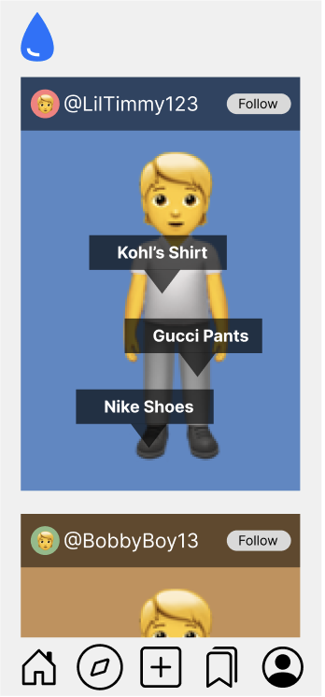
Project Overview
Apparel-centric social media app
Users post their daily outfits
Specific feed based on following and apparel interests
Affiliate links on products
Smaller account can have ability to get points for posting
AI recommends similar looking products
Saving users money while still getting the desired look

Slide 3
IDEALS Strength: Social Responsibility
This project focuses on providing users with affordable clothing options and promoting informed and budget-friendly shopping decisions
Transparency is prioritized by ensuring the suggested products accurately match user interests and are reliably sourced
It is ensured that the platform does not merely promote consumption but offers users genuine savings and supports financial awareness
AI recommendations are designed to be unbiased

Slide 4
IDEALS Weakness: Inclusiveness
Inclusiveness is necessary for creating an accessible welcoming, and diverse fashion platform
We need to ensure our platform does not cater to narrow fashion tastes or leave out underrepresented groups
our inclusiveness efforts are limited by a lack of diverse datasets for AI training and the need for broader feedback from users with different backgrounds

Slide 5
Broader Context Area: Four Principles Chart
 | Beneficence | Nonmaleficence | Respect for Autonomy | Justice
Public health, safety, and welfare | It’s a good social outlet for creative expression that is good for mental health. | Avoiding addictive algorithms that encourage doom-scrolling | Allowing users to choose who their profile and posts are shown to to protect privacy and safety | Making sure everyone’s usage of the app is safe for their mental health.
Global, cultural, and social | Allows users to share their sense of fashion with the world and inspire others | Not allowing hateful comments and speech to promote a safe and positive social environment | Gives users recommendations for culturally diverse clothing items. | Ensuring everyone on the app is treated kindly and with respect
Environmental | Encourages users to shop for and discover environmentally healthy and sustainable products | Avoiding business practices that negatively contribute to the environment | Allowing users to find environmentally conscious clothing articles | Giving everyone opportunities to choose from sustainable materials and clothing articles.
Economic | Allows consumers to find cheaper, similar outfits quicker | We avoid subscriptions that suck people in | Giving consumers more budget-friendly options to choose from | Everyone can earn dripdrop points from getting people to purchase apparel items

Slide 6
Potential Ethical Issues
Data Privacy: With an app centered around users and data, we have a responsibility to ensure data security and compliance.
AI Bias: AI-driven recommendations could inadvertently include biases favoring certain brands, styles, or cultures.
User Mental Health: Social media can lead to addictive behaviors and self-esteem issues. This is important to consider with an app based on sharing photos of yourself.
Transparency of Affiliate Links: If the app earns revenue from affiliate links, we should disclose this clearly to users to maintain trust.
Environmental Impact: Encouraging frequent purchases through the platform could contribute to fast fashion and its environmental impact.

